Slide 1

Machine Learning & Predictive Analytics
Amily Huang, Bharadwaj Kacharla, Duo Zhou, and Jenny Jiang

Slide 2

Agenda
Problem Statement
Exploratory Data Analysis & Feature Engineering
Analytic Approach
Model Building & Evaluation
Model Comparison
Conclusion
1
2
3
4
5
6

Slide 3

Problem Statement
Many people are struggling to get loans due to insufficient credit histories
Home Credit’s role is to ensure clients who is capable of repayment are not rejected from getting loans
Make default prediction given certain characteristics of a credit applicant can help load companies to minimize risk.
Home Credit provides positive and safe loan experience to clients
Home Credit is exploring avenues to unlock the complete potential of the data and thereby increasing the correct prediction of their clients' repayment abilities

Slide 4

EDA & Feature Engineering

Slide 5
Data Overview
Data
Shape
121 columns, 307511 rows
Each observation is an application
Application
Dataset
Data
Type
65 numerical variables
56 categorical variables
Target Variable
1 - client with payment difficulties (minor class)
0 - all other cases (major class)
minor class : major class = 8% : 92%

Slide 6
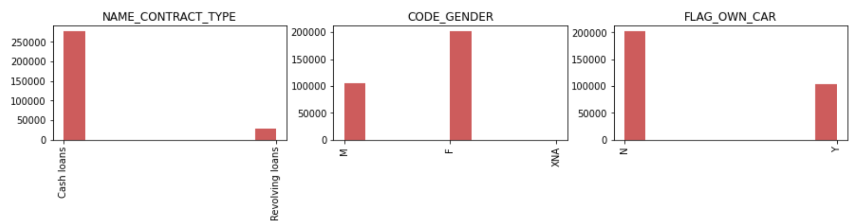
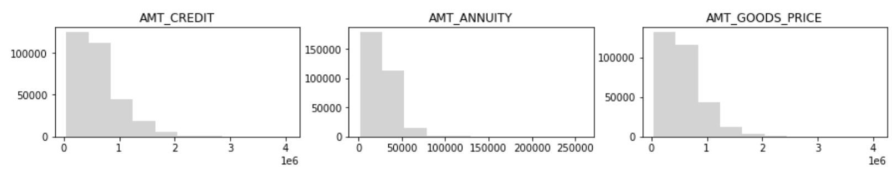
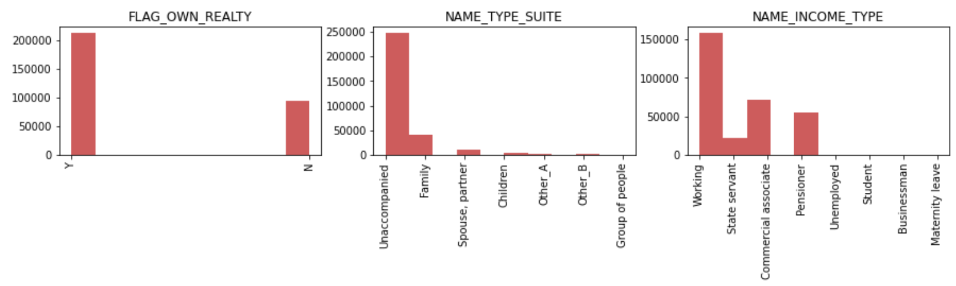
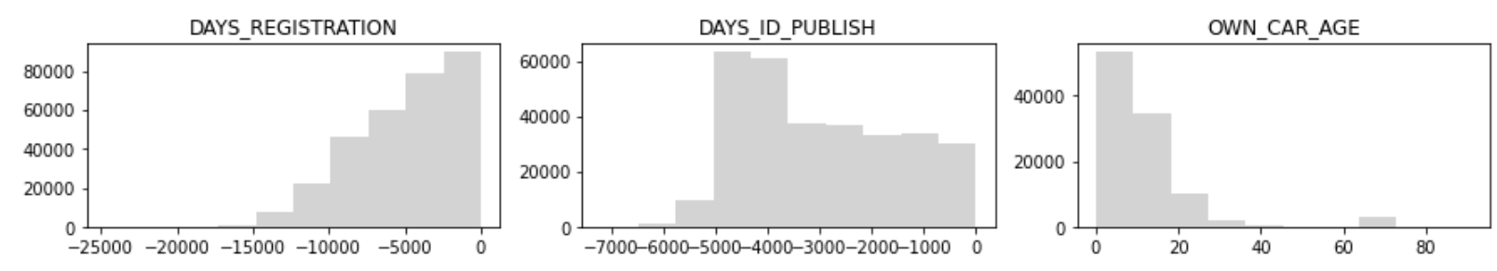
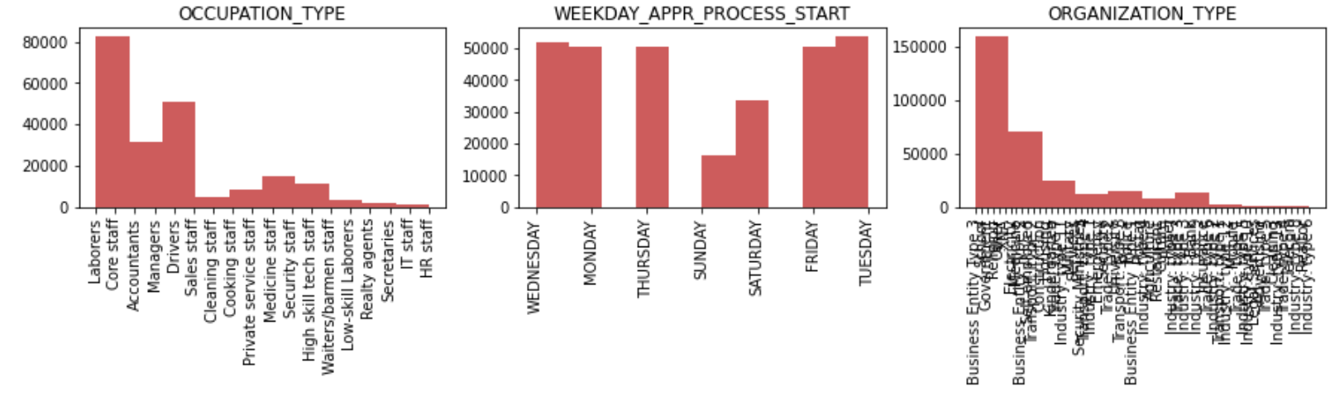
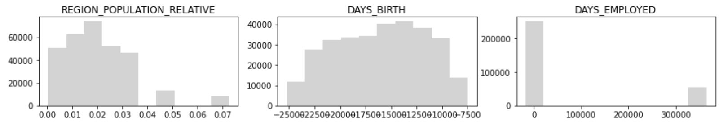
Univariate Analysis
Categorical Variables
Numerical Variables

Slide 7
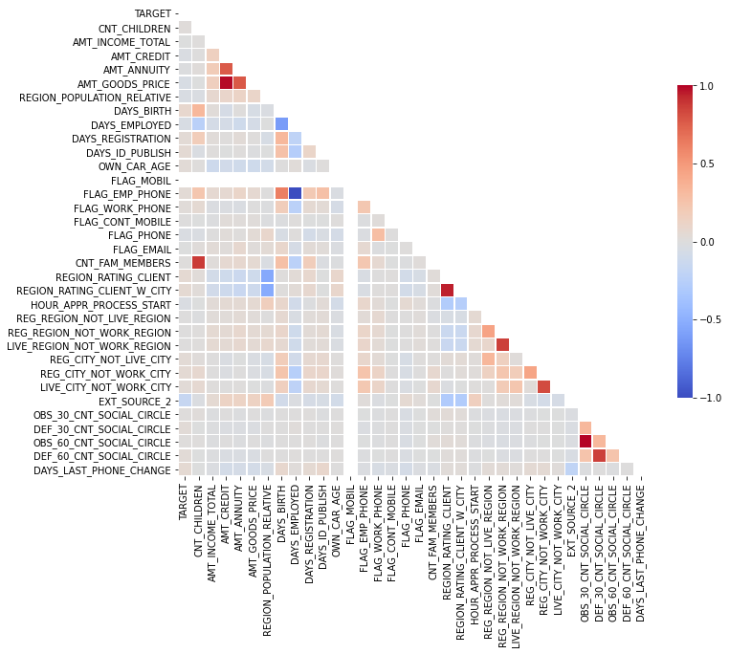
Bivariate Analysis
AMT_CREDIT → AMT_GOODS_PRICE corr: 0.98
Credit amount of the loan is highly correlated with the price of the goods
for which the loan is given
REGION_RATING_CLIENT → REGION_RATING_CLIENT_W_CITY corr: 0.95
Rating of the region where client lives is highly correlated with rating of the
region where client lives with taking city into account
CNT_FAM_MEMBERS → CNT_CHILDREN corr: 0.88
Number of family members does client have is highly correlated with
number of children the client has
LIVE_REGION_NOT WORK_REGION → REG_REGION_NOT_WORK_REGION corr: 0.86
Client’s contact address does not match work is highly correlated with client’s
permanent address does not match work address
LIVE_CITY_NOT_WORK_CITY → REG_CITY_NOT_WOTK_CITY corr: 0.82
Client's contact address does not match work address is highly correlated
with / client’s permanent address does not match work address
AMT_GOODS_PRICE → AMT_ANNUITY corr: 0.77
The price of the goods for which the loan is given is highly correlated
with the loan annuity

Slide 8
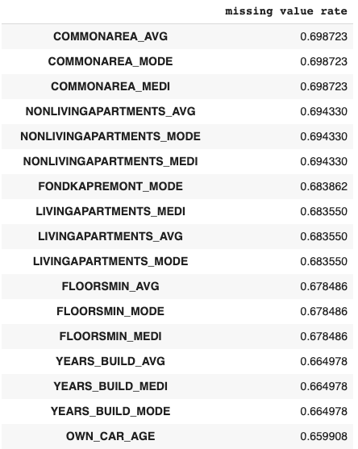
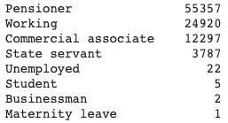
Missing Value
Identify variables with missing value rate above 15%
Inspect the mechanism of missing values. Determine whether those missing values are MCAR, MAR or MNAR
Except below two variables, no clear pattern is observed in other missing values. Therefore, we assume they are Missing Completely At Random
OWN_CAR_AGE : Most missing values are because people don’t have cars
OCCUPATION_TYPE: Most of the missing values in OCCUPATION_TYPE are people whose INCOME_TYPE is pensioner.
...

Slide 9
Feature Engineering Process
1
2
3
4
5
Drop Columns, Rows, Outliers
Train Test
Split
Impute Missing Values
Deal with
categorical variable
Normalize the data
Drop columns with missing value rate above 15%
Drop columns that are highly correlated (corr. > 0.7)
Drop rows with too many missing values given their target variable is 0
Drop outliers
Divide train and test set following same distribution
Impute columns with structural deficiency
Categorical variable:
Most common value
Numerical variable:
Median for skewed variable,
Mean for non-skewed variable
Reduce levels in some categorical variables
One-Hot Encoding

Slide 10

Analysis Approaches

Slide 11
Approaches for Imbalanced Data
Key challenge
The target class is imbalanced
This makes the optimization of classification accuracy meaningless
Adaptive re-sampling
The data are re-sampled in order to magnify the relative proportion of the minor class
Oversample minor class (Synthetic Minority Over-sampling Technique - SMOTE)
Under-sample major class (Random Sampling)
The classification algorithm is learned on re-sampled data
Cost-sensitive learning
Off-the-shelf classification algorithms are used
The loss function of the classification algorithm is modified to weight the classification errors differently for major and minor class
The misclassification cost is added to the loss function

Slide 12
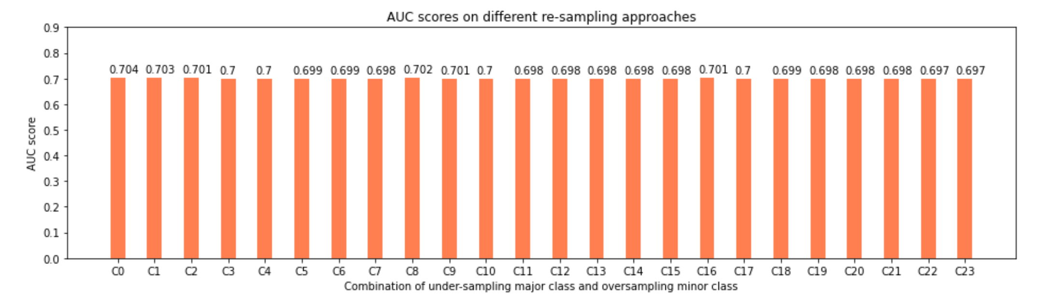
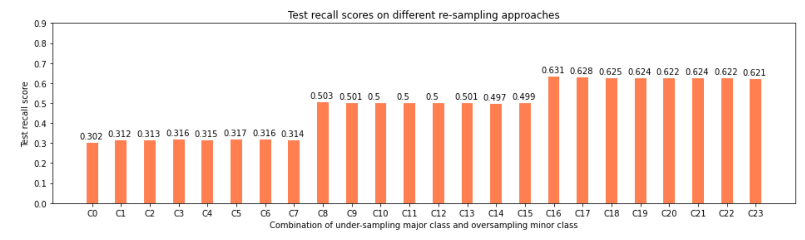
Adaptive re-sampling – Logistic Regression
Take Logistic Regression as an example:
Test AUC score on original data
Identify re-sampling strategy using Logistic Regression
Oversampling minor class using SMOTE; under-sampling major class using random sampling
The results of the two algorithms indicate that under-sampling major class to the sample size of minor class is the best strategy
Re-sampling doesn’t affect the AUC score, but increases the recall drastically
In our case, since correctly identifying a client is likely to default is more important, we will use recall as the evaluation metric.
0.70
Under-sampling to Minority Class
Test recall score on original data
0.0006

Slide 13
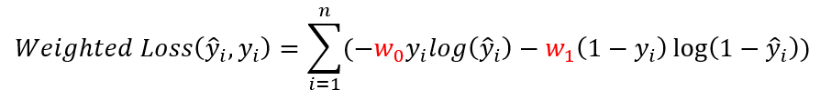
Cost-sensitive learning
Misclassification cost is added to loss function. Take log loss as an example:
A smaller weight is assigned to majority class while a larger weight is assigned to minority class
Conduct grid/random search weighs and use following weights:
Major class: 1
Minor class: Size of Major Class / Size of Minor Class
We can see that the BEST cost sensitive learning produces very similar results as the best resampling strategy

Slide 14

Imbalanced Data Approach Conclusion
Both under-sampling of majority class and cost-sensitive learning produce similar results with logistic regression
Three different scenarios will be applied to 4 different ML models(SVM, Random Forest, Boosting, and ANN):
Original Data without either re-sampling or cost-sensitive learning
Original Data with under sampling of major class to the same size of minor class. No cost-sensitive learning
Original Data without re-sampling, but different cost-sensitive learning rates applied for random/grid search

Slide 15
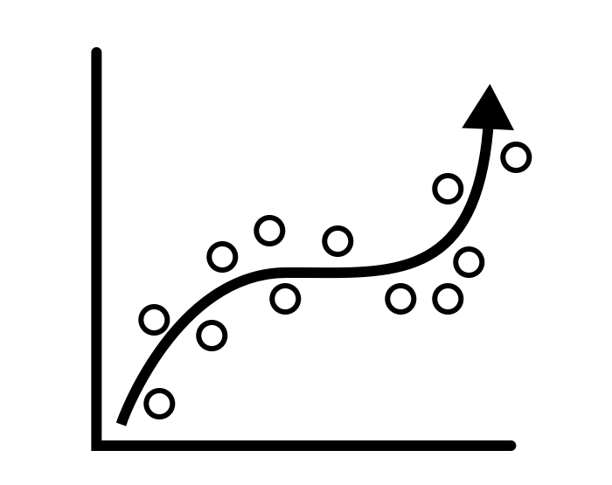
Model Building and Evaluation

Slide 16
Support Vector Machine
Train | Accuracy | Recall | AUC Score
Original Data with Cost Function Weight 1:1 | 0.918320 | 0.000655 | 0.698785
Under-sampling with Cost Function Weight 1:1 | 0.659225 | 0.629909 | 0.699494
Cost-sensitive with Cost Function Weight 1:4 | 0.910275 | 0.030916 | 0.629627
Several kernel options are used, and the linear kernel performs better
There is no sign of overfitting since the fitting scores for train and test are very close
The recall for original data is very close to zero
The result of cost-sensitive learning has good accuracy, but the recall is low
The best model is using under-sampling method. It has the best recall and auc score
Test | Accuracy | Recall | AUC Score
Original Data with Cost Function Weight 1:1 | 0.918265 | 0.000201 | 0.703843
Under-sampling with Cost Function Weight 1:1 | 0.663740 | 0.633837 | 0.704300
Cost-sensitive with Cost Function Weight 1:4 | 0.910044 | 0.027190 | 0.635207

Slide 17
Random Forest
Based on predetermined sampling techniques we’ve implemented Random Forest to test for both Recall and AUC metrics
Under-sampling and Weighted Learning methods perform significantly better compared to the other sampling strategies
Although, there is a significant increase in recall value, in scenarios like fraud detection it’s below industry standards
Train | Accuracy | Recall | AUC Score
Original Data with Cost Function Weight 1:1 | 0.999 | 0.999 | 1.00
Under-sampling with Cost Function Weight 1:1 | 0.768 | 0.775 | 0.855
Cost-sensitive with Cost Function Weight 1:12 | 0.675 | 0.700 | 0.756
Test | Accuracy | Recall | AUC Score
Original Data with Cost Function Weight 1:1 | 0.918 | 0.001 | 0.676
Under-sampling with Cost Function Weight 1:1 | 0.651 | 0.641 | 0.702
Cost-sensitive with Cost Function Weight 1:12 | 0.666 | 0.622 | 0.697

Slide 18
XGBoost
Different weights have been searched for cost-sensitive learning. The weight of 1:12 generates a higher recall than other weights
After applying under-sampling or cost-sensitive learning:
A significant drop in accuracy
A great boost in recall
AUC scores remain similar
Under-sampling approach produces the best recall result for test data
From the metrics of training data and test data, we can see there is no sign of overfitting
Train | Accuracy | Recall | AUC Score
Original Data with Cost Function Weight 1:1 | 0.9186 | 0.0050 | 0.7122
Under-sampling Data with Cost Function Weight 1:1 | 0.6556 | 0.6489 | 0.7127
Original Data with Cost Function Weight 1:12 | 0.6730 | 0.6595 | 0.7271
Test | Accuracy | Recall | AUC Score
Original Data with Cost Function Weight 1:1 | 0.9184 | 0.0028 | 0.7104
Under-sampling Data with Cost Function Weight 1:1 | 0.6559 | 0.6483 | 0.7080
Original Data with Cost Function Weight 1:12 | 0.6727 | 0.6415 | 0.7146

Slide 19
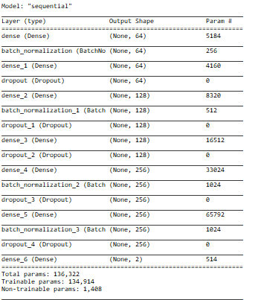
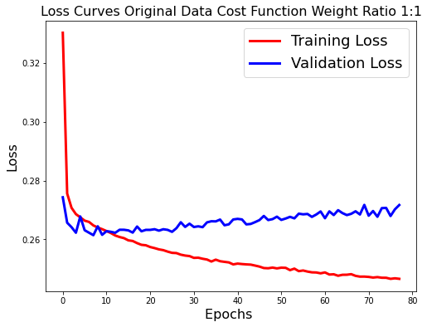
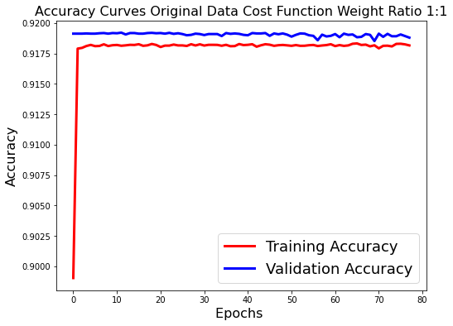
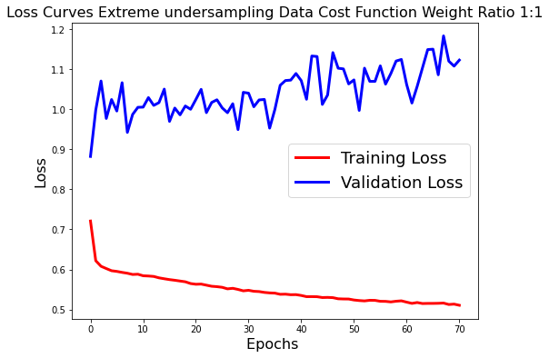
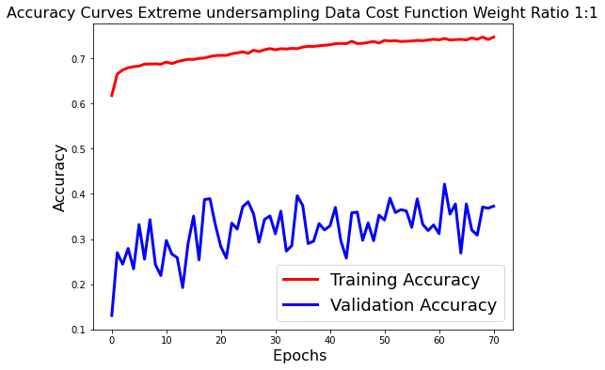
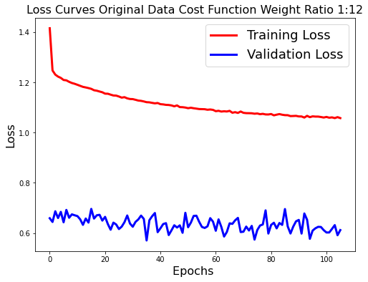
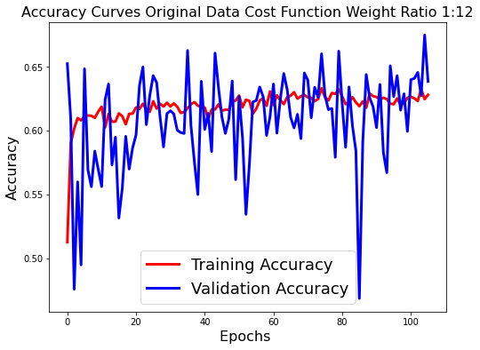
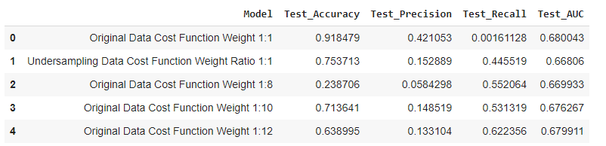
Artificial Neural Network
An ANN model was built with dropouts and batch normalization.
Both under sampling and original data showed clear sign of overfitting.
Cost-Sensitive Learning with the performed significantly better compared to the other scenarios without overfitting.
Test accuracy and test AUC scores are very similar. Cost-Sensitive Learning with Weight ratio of 1:12 gives the best recall scores of 0.622
No resampling & No Cost Sensitive Learning
Under-sampling & No Cost Sensitive Learning
No resampling & Cost Sensitive Learning weight ratio 1:12

Slide 20
Model Comparison
Based on the Test Recall and AUC values XGBoost has performed the best
Model | AUC | Recall
Random Forest (Under-sampling Data with Cost Function Weight 1:1) | 0.7019 | 0.6418
ANN (Original Data with Cost Function Weight 1:12) | 0.6799 | 0.6222
SVM (Under-sampling Data with Cost Function Weight 1:1) | 0.7043 | 0.6338
XGBoost (Under-sampling Data with Cost Function Weight 1:1) | 0.7080 | 0.6483

Slide 21
Conclusion & Future Work
Conclusion
For this project, applying different resampling strategy or cost sensitive learning weights on different models do not significantly change test AUC scores
However, Recall increases significantly by applying those techniques to offset the imbalanced data effect
The model that gives the best test recall result is XGBoost with majority class under-sampled to the size of minority class and no cost sensitive learning
Future Work
Inclusion of additional features may increase the recall percentage; additional feature engineering analysis is recommended
Instead of simple mean and median imputation, other interpolative or regressive methods can be used for imputation
Other selection criteria can be used to split the trees in Random Forest, i.e., binary cross-entropy
Auto encoder can be employed to conduct outlier detection
GAN can be used to generate additional minority class observations
Different optimizers and learning rates can employed for ANN given sufficient computational resources and time

Slide 22
Thank You
Q & A

